Slide 1
Pinnacle Webinar Series
The Importance of Staying Connected While Practicing Physical Distancing

Slide 2
Pinnacle Webinar Series
Sponsored by
Pinnacle Education Partner

Slide 3
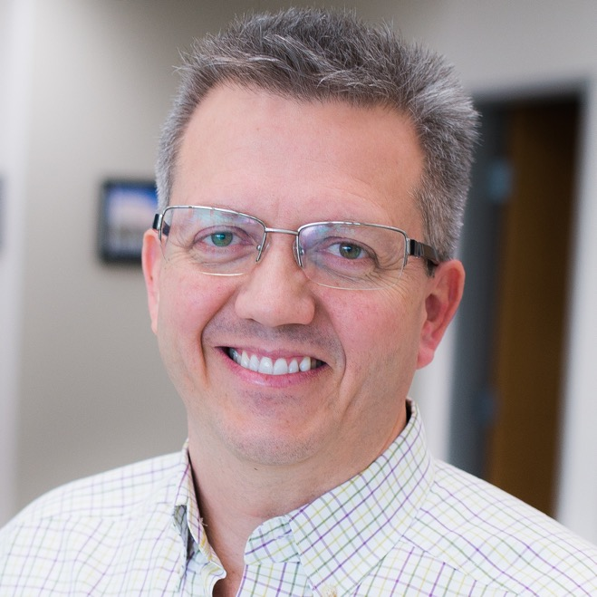
Today’s Presenters
Todd Stout
Founder & President
FirstWatch
Mike Taigman
Improvement Guide
FirstWatch
Notes:
Skip Kirkwood is an EMS executive, educator, consultant, and attorney with a broad range of public safety experience, which while predominantly in EMS, included law enforcement and fire suppression. He holds a Bachelor of Science from the University of the State of New York, a Master of Science in Health Administration from Central Michigan University, and a Juris Doctorate (with Honors) from the Rutgers University School of Law.
John R. Brophy, MSHS, FACPE started his EMS career over 3 decades ago. He has served in provider and leadership roles in both operations and communications. He is currently the Director of Corporate Responsibility for Mobile Medical Response, Inc. in Michigan. He has presented a variety of topics at local, regional, national, and international venues. He is the author of Leadership Essentials for Emergency Medical Services and multiple other books on leadership topics. He served as a Corpsman in the US Navy and is currently serving as Lieutenant on his local fire department.

Slide 5
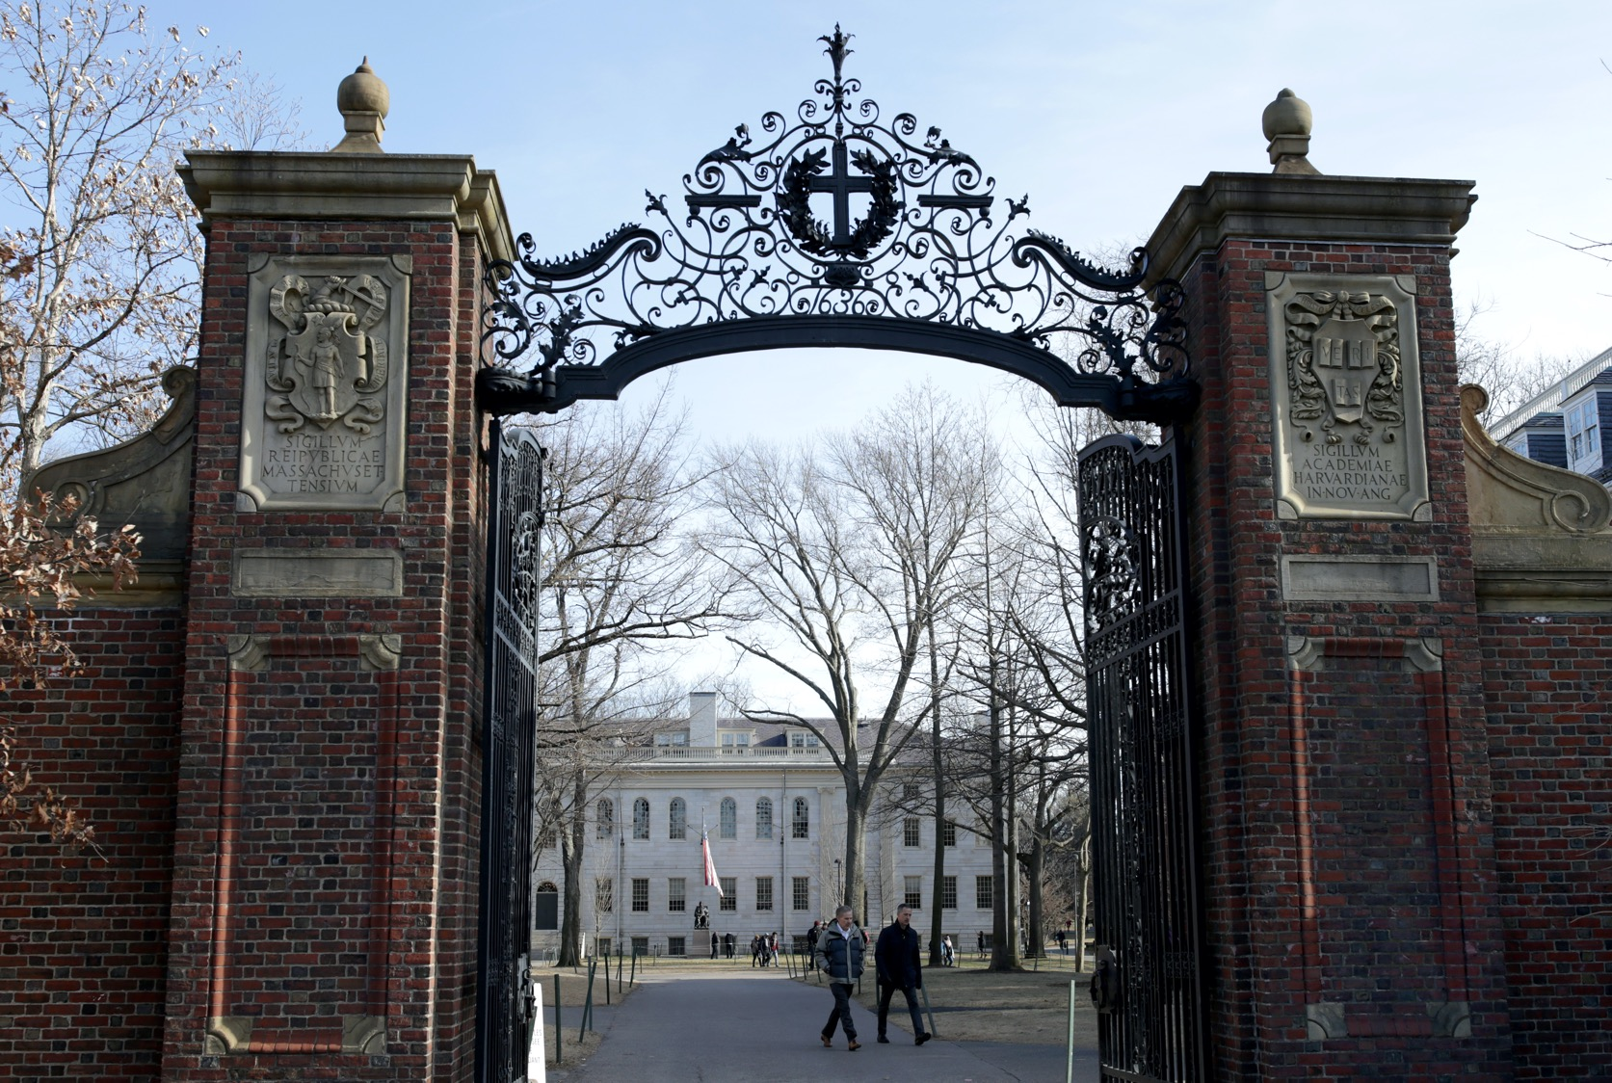

Slide 7
Alexithymia

Slide 8
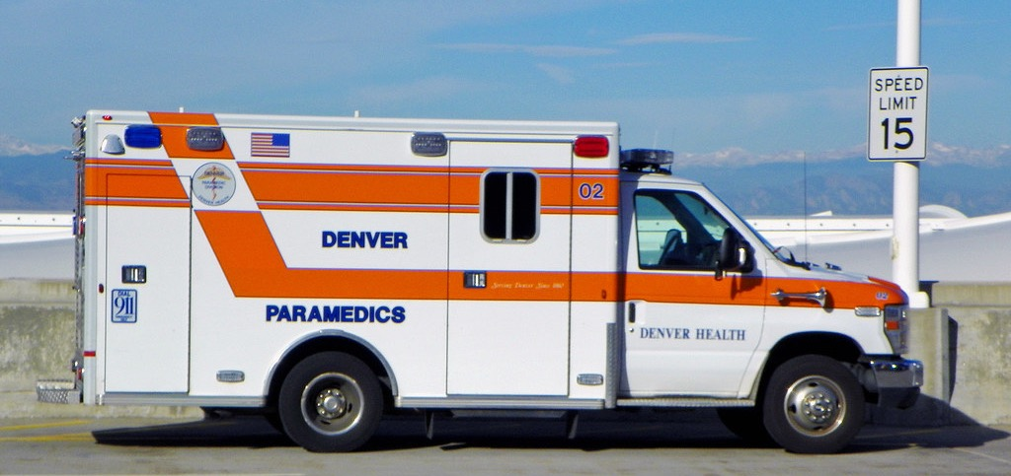

Slide 12
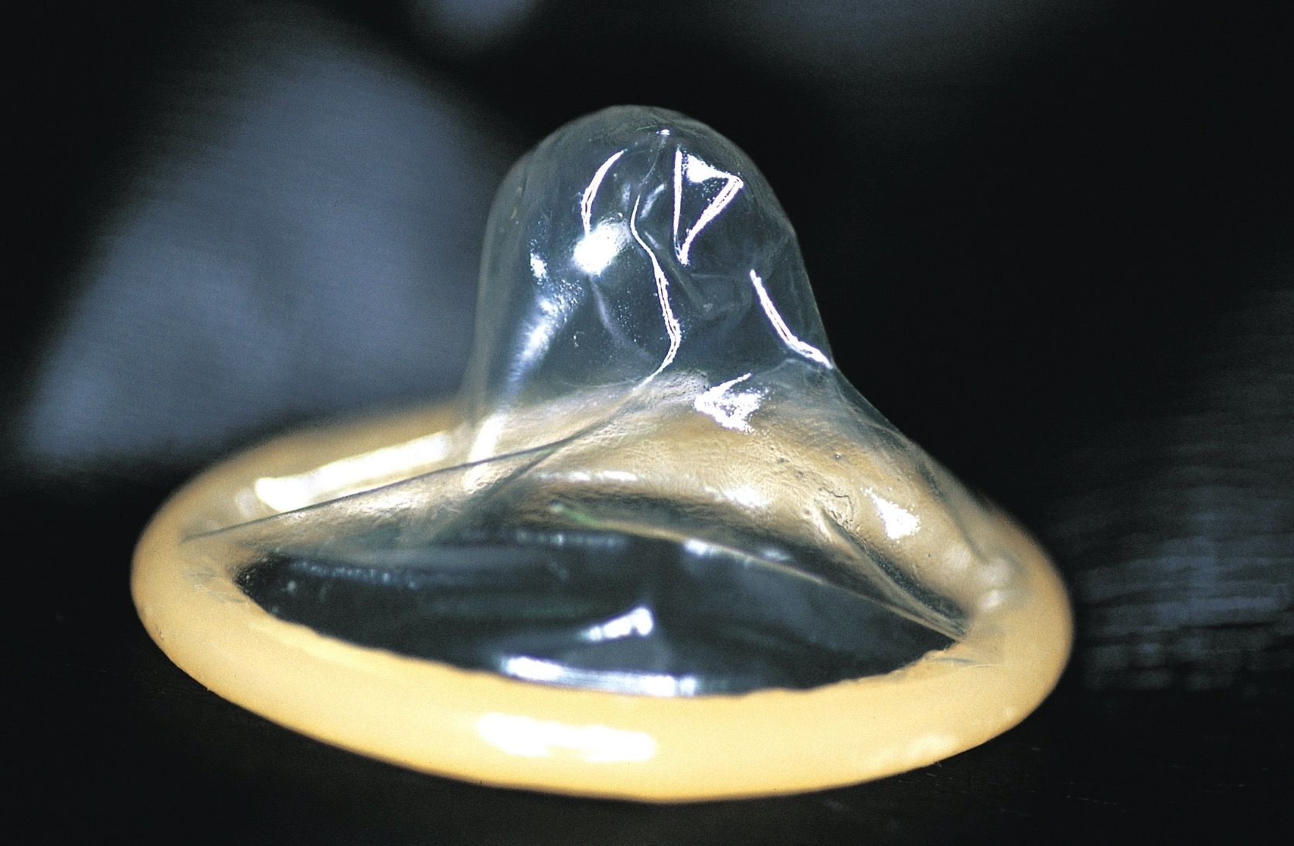

Slide 14
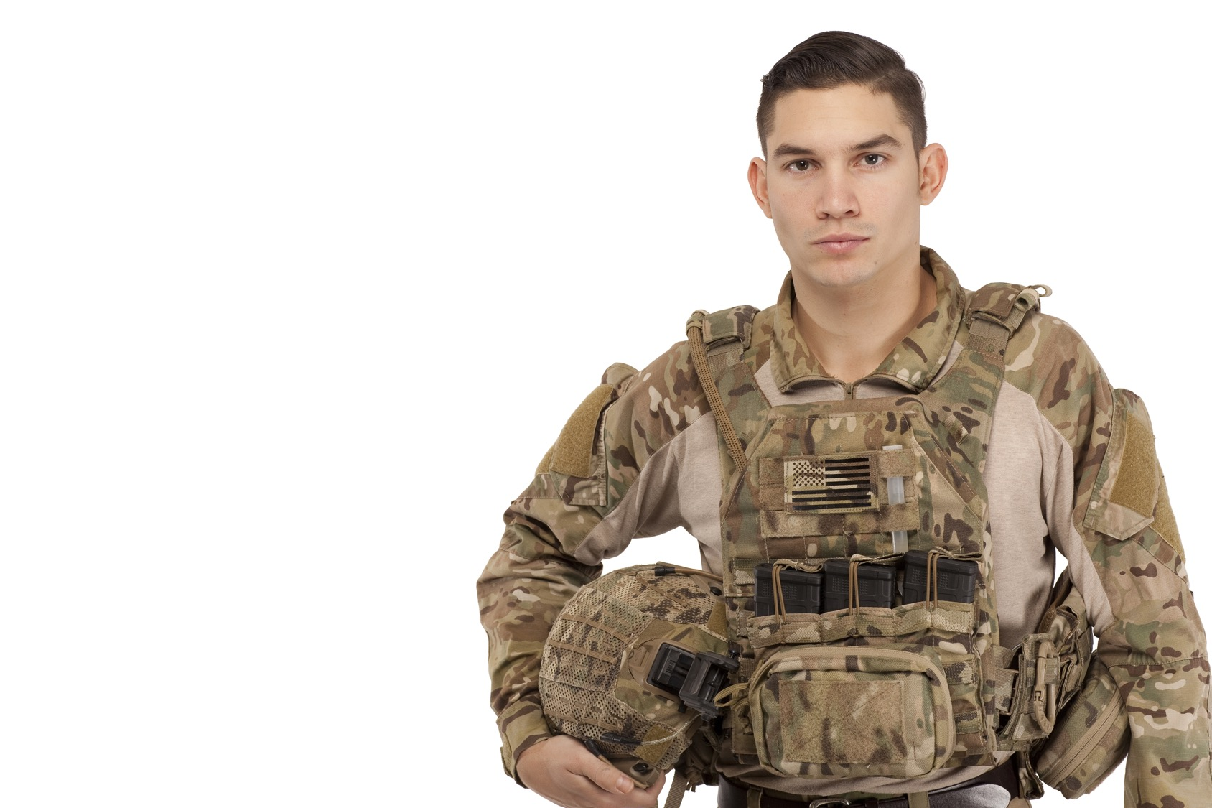

Slide 15
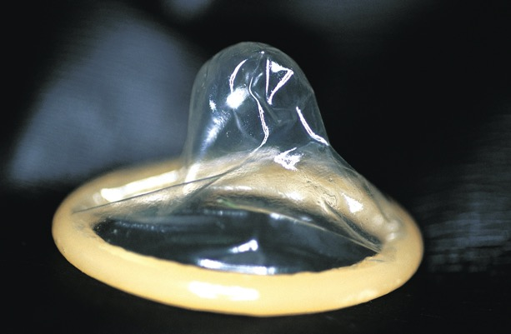
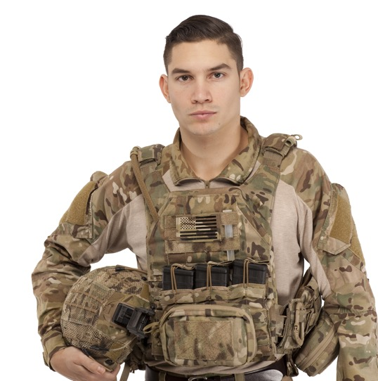
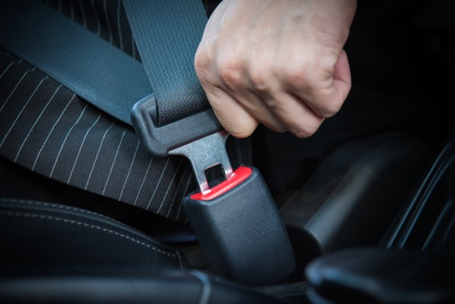

Slide 17
Empathy

Slide 18
Empathy
Motor Mimicry

Slide 19
Empathy
Motor Mimicry
Entrainment

Slide 26
Loneliness + Isolation = Hopelessness
Anger
Depression

Slide 33
Seen

Slide 34
Safe

Slide 35
Soothed

Slide 36
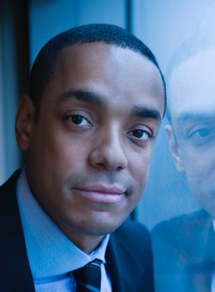
Seen
+

Slide 37
Seen
+
Safe
+

Slide 38
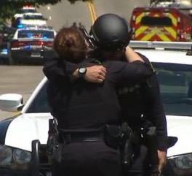
Seen
+
Safe
+
Soothed

Slide 39
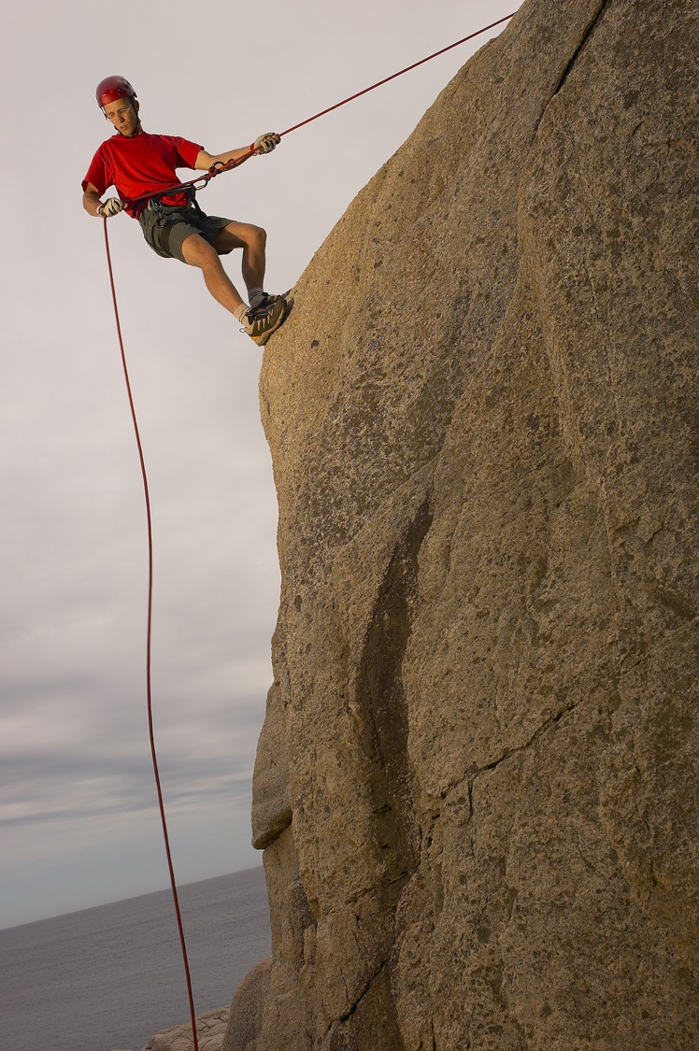
Seen
+
Safe
+
Soothed
Secure
Connection
=

Slide 41
Rupture

Slide 42
Rupture
Repair

Slide 43
Open Loop Nature of Limbic System

Slide 47
Open Loop Nature of Limbic System
Interpersonal Limbic Regulation

Slide 48
Alter hormone levels, cardiovascular functions, sleep rhythms, immune functions

Slide 49
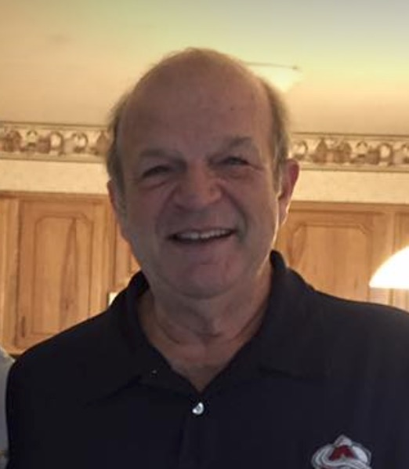

Slide 50
Call 5 people a day….every day

Slide 51
Call 5 people a day….every day
For no reason

Slide 52
Call 5 people a day….every day
For no reason
Say Hi

Slide 53
Call 5 people a day….every day
For no reason
Say Hi
Maybe ask a question

Slide 54
Call 5 people a day….every day
For no reason
Say Hi
Maybe ask a question
Then shut up and listen

Slide 55
Tactical Breathing
Breath In 4 Seconds
Hold
4 Seconds
Hold
4 Seconds
Breath Out 4 Seconds

Slide 56
Given the choice of anyone in the world who would you want as a dinner guest?

Slide 57
What would constitute a “perfect” day for you?

Slide 58
What do you feel most grateful for?

Slide 59
What do you value most in a friendship?

Slide 60
What do you value most in a friendship?

Slide 61
When did you last cry by yourself?

Slide 62
What is your most treasured memory?

Slide 64
Chris Galton

Slide 65
Chris Galton MD
Anesthesiologist
Intensivist
Paramedic
Medical Director
Mercy Air

Slide 66
https://www.firstwatch.net/rf-individual/

Slide 67
How it works
Proactive risk assessment
AI-powered automated coaching
Instant help when you need it
https://www.firstwatch.net/rf-individual/

Slide 68
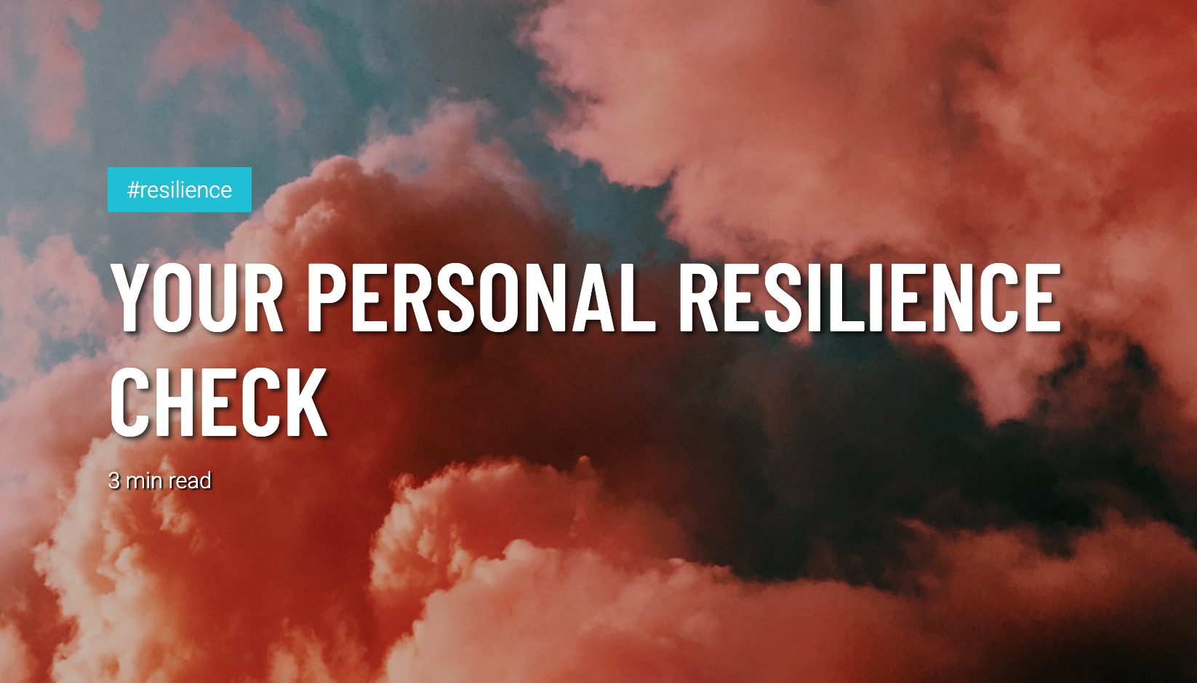
https://www.firstwatch.net/rf-individual/

Slide 69
https://www.firstwatch.net/rf-individual/

Slide 70
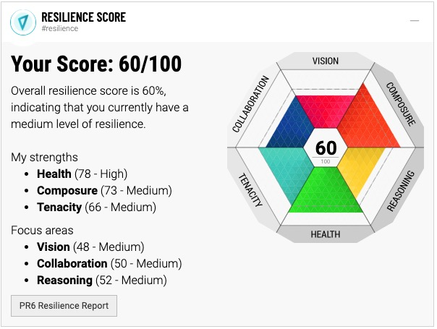
https://www.firstwatch.net/rf-individual/

Slide 71
Strategy
OUR
A resilience coach in the pocket of every person
https://www.firstwatch.net/rf-individual/
Notes:
This is Driven

Slide 72
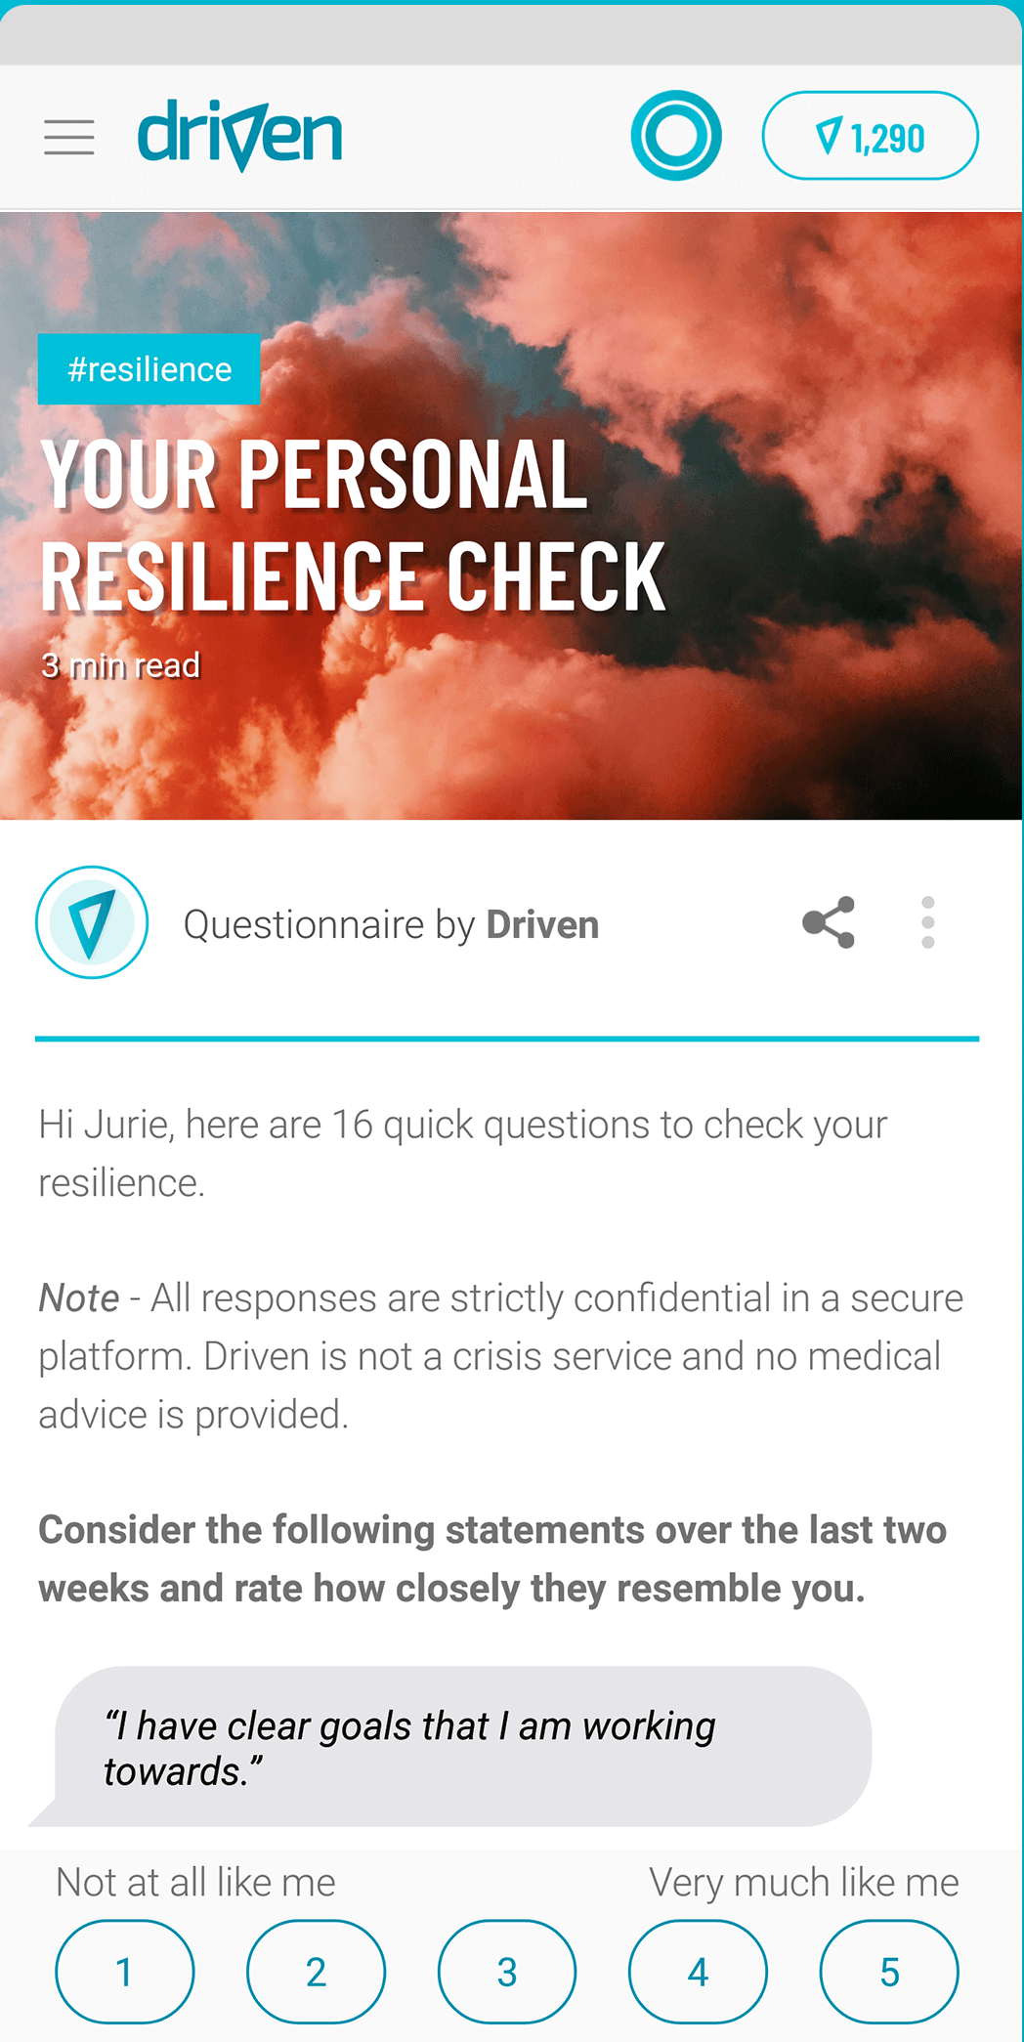
Scientifically assess your resilience
https://www.firstwatch.net/rf-individual/

Slide 73
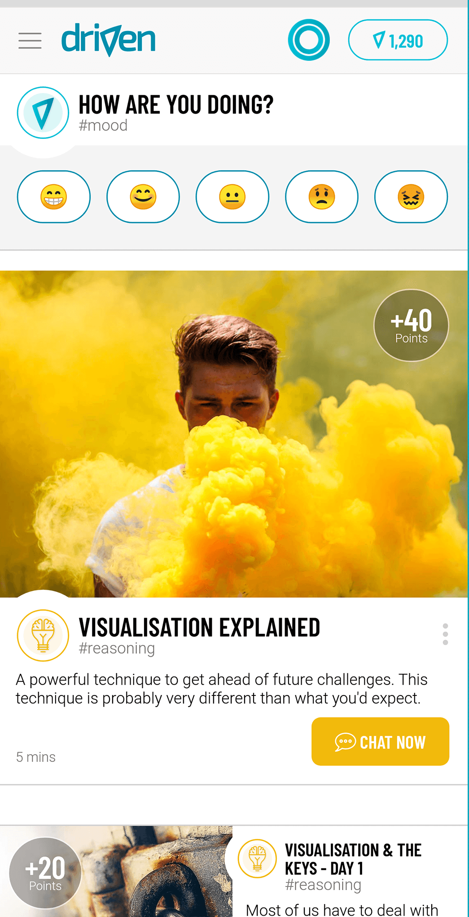
Learn skills every day to build your resilience!
https://www.firstwatch.net/rf-individual/

Slide 74
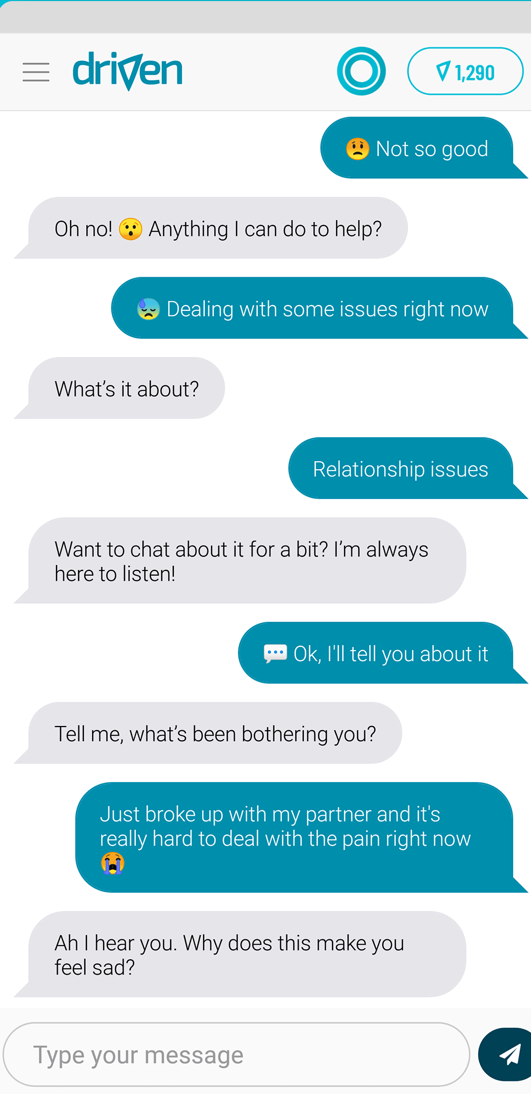
Chat anytime you like.
https://www.firstwatch.net/rf-individual/

Slide 75
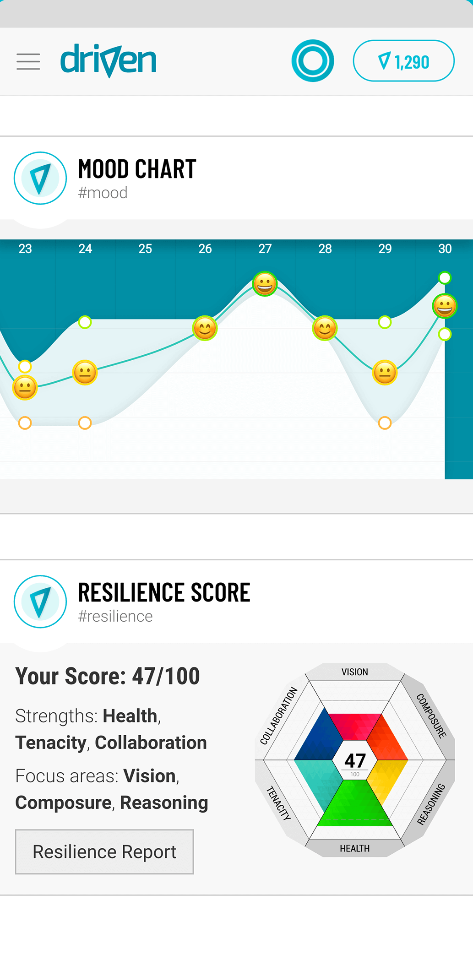
Track your progress!
https://www.firstwatch.net/rf-individual/

Slide 76
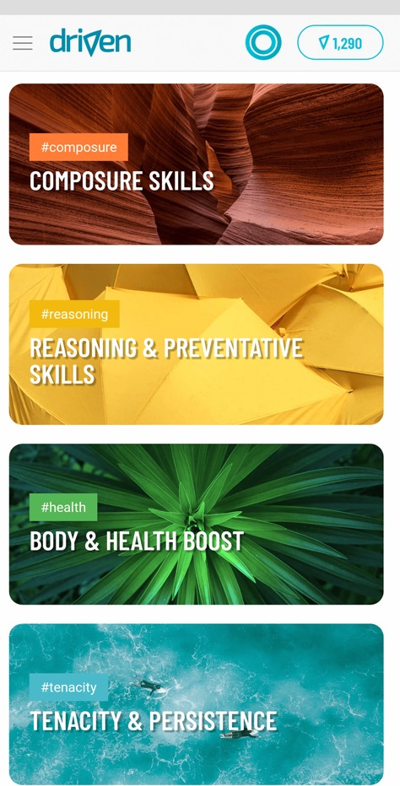
Over 200 Skills to explore
https://www.firstwatch.net/rf-individual/

Slide 77
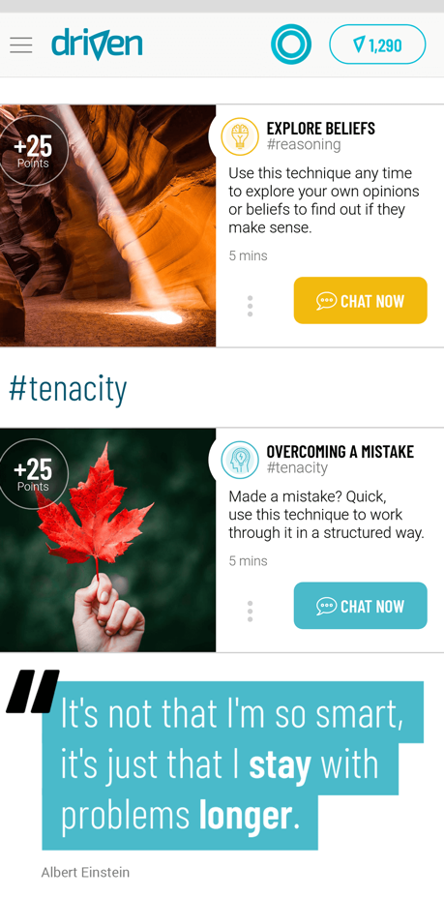
Quick tools to get you back on track fast
https://www.firstwatch.net/rf-individual/

Slide 78
https://www.firstwatch.net/rf-individual/

Slide 79
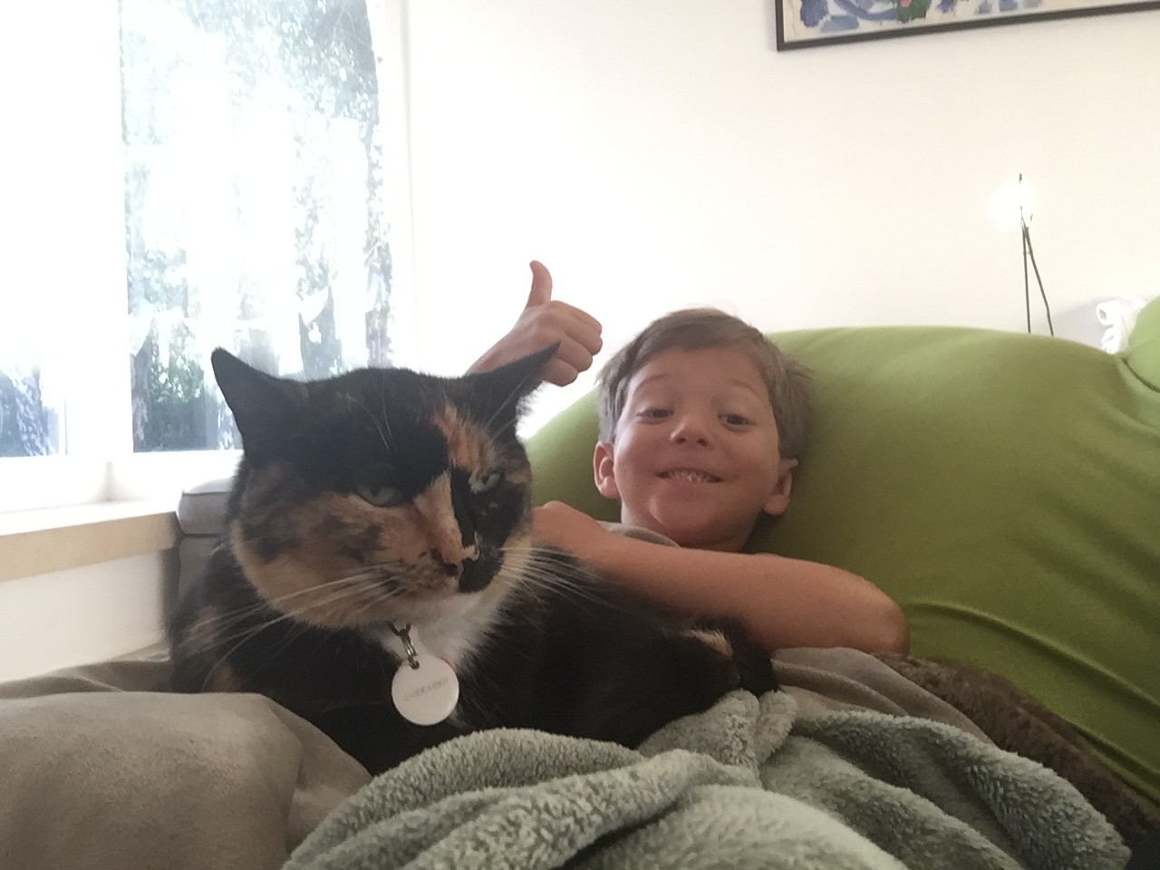
Stay Cool and Connected
Thank You
510-593-5730
mtaigman@firstwatch.net

Slide 80
QUESTIONS

Slide 81
Special Thanks
Pinnacle Strategic Partner
Pinnacle Education Partner

Slide 82
www.pinnacle-ems.com

