Slide 1
COVID-19 Best Practices
Station/Crew Protective Measures
Crew Safety
Response
Department PPE
Checklist
Aerosol Safety
O₂ – Airway Mgt.
Transportation
Notify Hospital
Decontamination
Crew Decon Checklist: Transport Unit
Crew Decon Checklist: Non-transport Unit
Transport Unit Decon Guidelines
PPE Preservation
PPE Conservation
UV-C N-95 Mask Disinfection
Station Safety & Sick Personnel
Workflow
BC Algorithm
14-Day Symptom Tracking
Daily Shift Tracking
Checklists
COVID-19
PROCEDURE MANUAL
OPERATIONAL PERIOD
July 30 – August 13, 2020
July / August
SU | M | T | W | TH | F | SA
 |  |  |  | 30 | 31 | 1
2 | 3 | 4 | 5 | 6 | 7 | 8
9 | 10 | 11 | 12 | 13 | 14 | 15
16 | 17 | 18 | 19 | 20 | 21 | 22
23 | 24 | 25 | 26 | 27 | 28 | 29
This guideline is dynamic and may change daily based on the most current recommendations. It does NOT cover every situation.

Slide 2
July 30 – August 13, 2020
Subject to Change
COVID-19 Best Practices
Station/Crew Protective Measures
Crew Safety
Response
Department PPE
Checklist
Aerosol Safety
O₂ – Airway Mgt.
Transportation
Notify Hospital
Decontamination
Crew Decon Checklist: Transport Unit
Crew Decon Checklist: Non-transport Unit
Transport Unit Decon Checklist
PPE Preservation
PPE Conservation
UV-C N-95 Mask Disinfection
Station Safety & Sick Personnel
Workflow
BC Algorithm
14-Day Symptom Tracking
Daily Shift Tracking
Fire Station & Crew Protective Measures
Purpose
Protect the South County Fire workforce so we can continue to serve the public
Protect patients and families within our community and response area
Provide a safe work environment and protect fire stations from contamination
Actions
Restrict ALL visitor access, including citizens and family members. Post signage on entry doors (as provided).
Restrict fire station access for anyone (employees and citizens) showing signs of fever or respiratory illness.
Limit fire station access to a single entry point (as feasible).
When entering fire station, perform:
hand hygiene with alcohol-based cleaner
boot decontamination with disinfectant (CaviCide Spray or wipes)
Every employee needs to proactively self-monitor for symptoms
At start of shift, once during shift, and going off shift:
Complete daily station cleaning and decontamination as posted in Operative IQ daily tasks.
Employee Self-Assessment and Symptoms Monitored
At start of shift and minimum 2 times during shift day, do you have:
Cough
Shortness of breath or difficulty breathing
Fever (checked by thermometer)
Chills or feeling feverish
Muscle Pain
Sore throat
New loss of taste or smell
GI-nausea, vomiting or diarrhea
Extreme fatigue
If “YES” to ANY symptoms, IMMEDIATELY notify your station Captain or Battalion Chief
If “NO” to ALL symptoms, continue self-monitoring throughout shift

Slide 3
July 30 – August 13, 2020
Subject to Change
COVID-19 Best Practices
Station/Crew Protective Measures
Crew Safety
Response
Department PPE
Checklist
Aerosol Safety
O₂ – Airway Mgt.
Transportation
Notify Hospital
Decontamination
Crew Decon Checklist: Transport Unit
Crew Decon Checklist: Non-transport Unit
Transport Unit Decon Checklist
PPE Preservation
PPE Conservation
UV-C N-95 Mask Disinfection
Station Safety & Sick Personnel
Workflow
BC Algorithm
14-Day Symptom Tracking
Daily Shift Tracking
Fire Station Strategies for Crew Safety
Virus Transmissibility
Evidence shows transmission of COVID-19 is possible through:
Talking/normal breathing (not just coughing, sneezing, droplet contact)
AND
By infected people who are pre-symptomatic or asymptomatic and showing mild to no symptoms
Strategies To Limit COVID-19 Transmission to On-Duty Crews
Social Distancing: Maintain 6 feet separation
Surgical Masks Mandatory in stations except when:
Eating (practice good social distancing or eat alone), or
Alone in a room (bedroom, working out, office, etc)
Outside and able to maintain social distancing
Masks required when driving together in apparatus
Wash hands thoroughly and often
Optimize ventilation in station (keeping security in mind)
Complete daily station cleaning and decontamination as posted in Operative IQ daily tasks and throughout the day
Station Activities
1. Kitchen and Mealtime:
Limit trips to grocery store – wear surgical masks if you go
Modify group meals to allow for social distancing
Ensure everyone is washing hands
Get your own plate and utensils
Move or add tables to allow 6 feet separation
Clean early and clean often – true for whole station, especially common areas and high-contact surfaces
2. Workouts:
Limit number of people working out at one time
Clean any equipment you use EVERY time
Open windows while working out – turn on fans, if available
Be mindful of station security – close windows when done
3. Station Shoes and Duty Boots:
Consider using station shoes
Consider keeping duty boots in the apparatus bay
At a minimum, decon duty boots before entering station

Slide 4
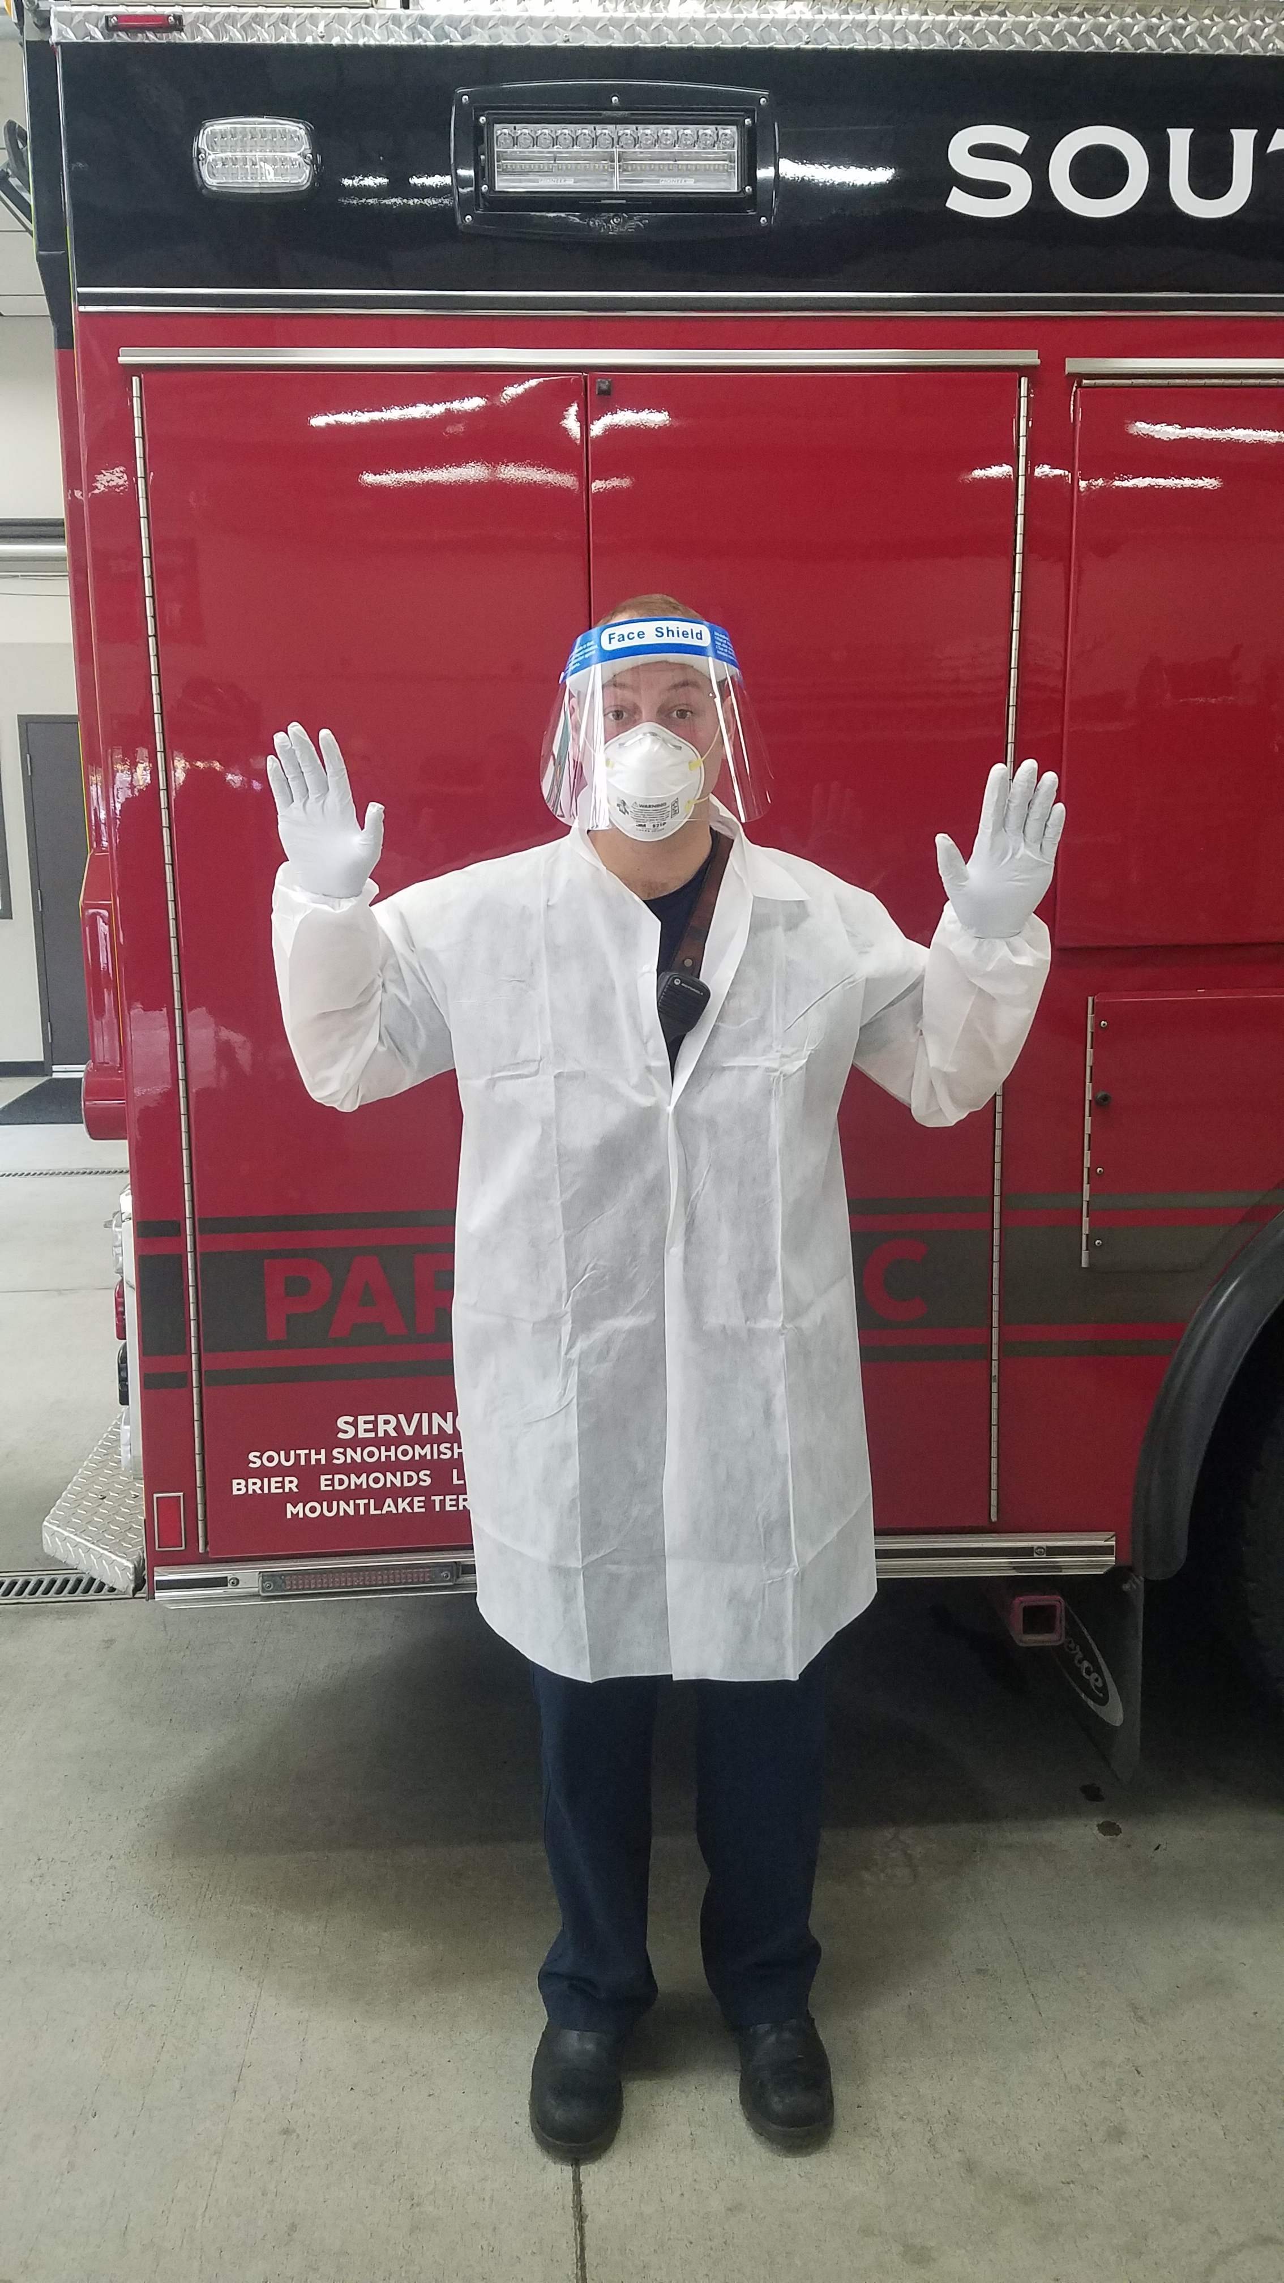
July 30 – August 13, 2020
Subject to Change
COVID-19 Best Practices
Station/Crew Protective Measures
Crew Safety
Response
Department PPE
Checklist
Aerosol Safety
O₂ – Airway Mgt.
Transportation
Notify Hospital
Decontamination
Crew Decon Checklist: Transport Unit
Crew Decon Checklist: Non-transport Unit
Transport Unit Decon Checklist
PPE Preservation
PPE Conservation
UV-C N-95 Mask Disinfection
Station Safety & Sick Personnel
Workflow
BC Algorithm
14-Day Symptom Tracking
Daily Shift Tracking
Level III / High Level PPE
N-95 Mask
Face shield (no safety glasses required) or goggles
Gown
Gloves
Shoe covers optional
PPE
ON
Donning Sequence: M E G G
Mask
Eyes (Goggles/Face Shield)
Gown
Gloves
PPE
OFF
Doffing Sequence (reverse donning): G G E M
Gloves
Gown
Eyes (Goggles/Face Shield)
Mask

Slide 5
July 30 – August 13, 2020
Subject to Change
COVID-19 Best Practices
Station/Crew Protective Measures
Crew Safety
Response
Department PPE
Checklist
Aerosol Safety
O₂ – Airway Mgt.
Transportation
Notify Hospital
Decontamination
Crew Decon Checklist: Transport Unit
Crew Decon Checklist: Non-transport Unit
Transport Unit Decon Checklist
PPE Preservation
PPE Conservation
UV-C N-95 Mask Disinfection
Station Safety & Sick Personnel
Workflow
BC Algorithm
14-Day Symptom Tracking
Daily Shift Tracking
Checklist: COVID-19 Response
ALL EMS Calls: High Precaution – Level III
1. Wear PPE: N95, goggles or face shield, gown, gloves
At a minimum, wear mask while responding to calls
2. Surgical mask on ALL patients
3. Treatment Precaution & PPE Preservation (use following and best judgment):
Door triage every patient (minimum 6 ft separation)
Patient walks to front door, if appropriate
Limit number of crew in contact with patient
Second-in crews: only dress number providers needed to treat patient
NO ORAL TEMPERATURES
If possible, limit or avoid aerosol procedures (eg. intubation, BVM, suctioning, iGel, CPAP, nebulized medications, non-rebreather with no patient mask): see below “Aerosol Generating Procedure Precautions”
4. Standards of Care have NOT changed:
Protocols and expectations for complete patient assessment, treatment and transport are still in effect
Transporting Instructions
Isolate ambulance driver from patient compartment
Driver: remove gloves, gown, & goggles/face shield; keep mask ON
Minimize number of providers in back of unit
Do NOT transport family members of any patient except parents/ guardians, POA, special needs
*Note: Per CDC, hospitals not accepting any visitors – some possible exceptions for end of life situations
Ventilation:
Maximize ventilation with transport of any suspected COVID-19 patient
Back of rig: use exhaust fans and open windows to create airflow
Driver area: open outside air vents and turn fans to highest setting

Slide 6
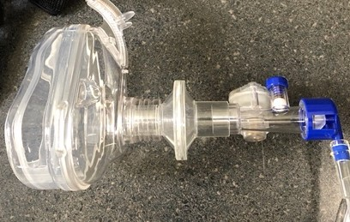
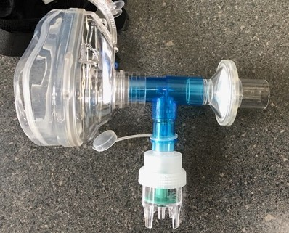
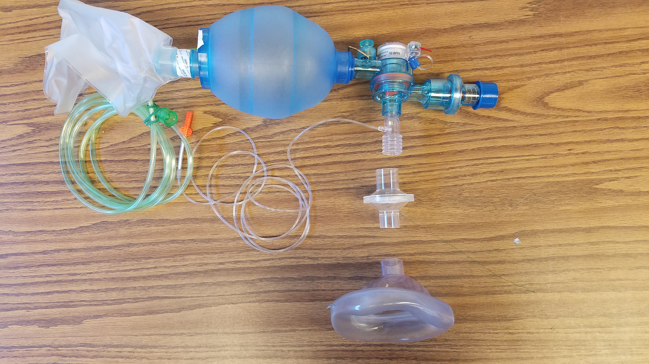
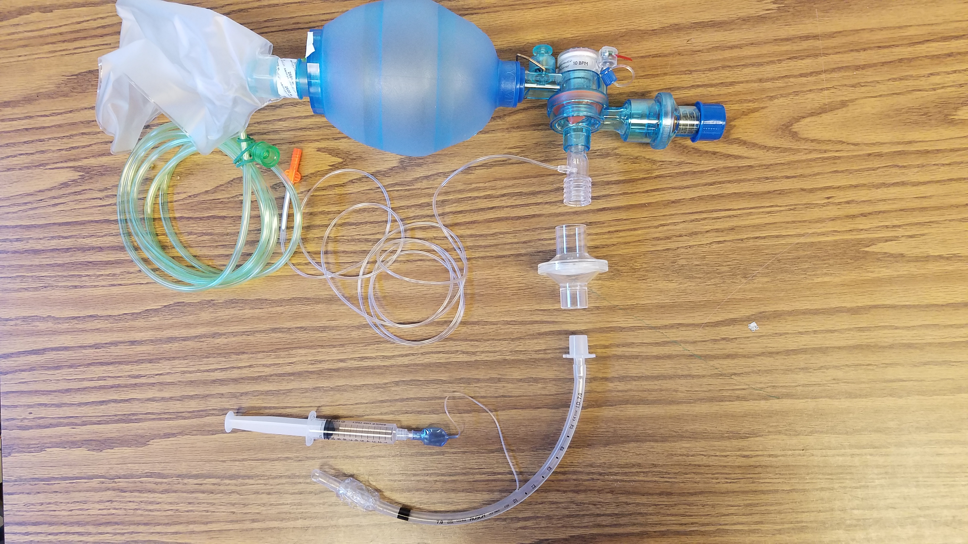
July 30 – August 13, 2020
Subject to Change
COVID-19 Best Practices
Station/Crew Protective Measures
Crew Safety
Response
Department PPE
Checklist
Aerosol Safety
O₂ – Airway Mgt.
Transportation
Notify Hospital
Decontamination
Crew Decon Checklist: Transport Unit
Crew Decon Checklist: Non-transport Unit
Transport Unit Decon Checklist
PPE Preservation
PPE Conservation
UV-C N-95 Mask Disinfection
Station Safety & Sick Personnel
Workflow
BC Algorithm
14-Day Symptom Tracking
Daily Shift Tracking
Oxygen or Advanced Airway Management
Illustrations are examples only. Specific equipment may vary by agency.
Nasal Cannula
Place nasal cannula
Place surgical mask on face
Non-Rebreather
Place non-rebreather mask
Place surgical mask over the face on top of NRB mask
CPAP
Place HEPA directly on mask
Nebulizer
Place HEPA filter on end of T
BVM
Place HEPA filter between mask and BVM
Endotracheal Tube or I-gel
Place HEPA filter between ETT or I-gel and BVM
Aerosol Generating Procedure Precautions
If patient condition REQUIRES invasive airway intervention:
BVMs and CPAPs should be equipped with HEPA filters
FOLLOW STANDARD AIRWAY PROTOCOLS for patients needing advanced airway
Evidence shows our standard protocols safest for providers
DO NOT USE VENTILATORS
Use CPAP and nebulized meds as last resort.
Consider other appropriate treatments first.
Maximize area ventilation: open doors/windows, use exhaust fans
Contact Medical Control for guidance, as needed
See decon checklists for specialized steps after aerosol procedures

Slide 7
July 30 – August 13, 2020
Subject to Change
COVID-19 Best Practices
Station/Crew Protective Measures
Crew Safety
Response
Department PPE
Checklist
Aerosol Safety
O₂ – Airway Mgt.
Transportation
Notify Hospital
Decontamination
Crew Decon Checklist: Transport Unit
Crew Decon Checklist: Non-transport Unit
Transport Unit Decon Checklist
PPE Preservation
PPE Conservation
UV-C N-95 Mask Disinfection
Station Safety & Sick Personnel
Workflow
BC Algorithm
14-Day Symptom Tracking
Daily Shift Tracking
EMS: COVID-19 Hospital Notification Checklist
COVID-19 Symptoms?
Cough
Shortness of breath or difficulty breathing
Fever
Chills
Muscle pain
Sore throat
New loss of taste or smell
Nausea, vomiting, or diarrhea
Possible exposure to known or suspected COVID patient
YES to ANY symptoms?
Notify hospital of a HIGH risk isolation patient
If NO to ALL: standard hospital notification
At Hospital:
Driver: register patient, coordinate with staff
Alert hospital if aerosol-generating procedures
Provider: Doors and windows open for ventilation
Consider keeping patient in rig until ready for transfer
Do not doff PPE until patient transfer
Don clean PPE for gurney decontamination
Doff gurney decon PPE prior to dressing clean gurney

Slide 8
July 30 – August 13, 2020
Subject to Change
COVID-19 Best Practices
Station/Crew Protective Measures
Crew Safety
Response
Department PPE
Checklist
Aerosol Safety
O₂ – Airway Mgt.
Transportation
Notify Hospital
Decontamination
Crew Decon Checklist: Transport Unit
Crew Decon Checklist: Non-transport Unit
Transport Unit Decon Checklist
PPE Preservation
PPE Conservation
UV-C N-95 Mask Disinfection
Station Safety & Sick Personnel
Workflow
BC Algorithm
14-Day Symptom Tracking
Daily Shift Tracking
Crew DECON Checklist – Transport Unit
General Principles:
Conduct daily deep cleaning of stations and apparatus throughout the shift, as appropriate
CONDUCT ALL PRIMARY DECON BEFORE ENTERING STATION. DO NOT CONTAMINATE STATION
Transport unit crews will perform decon at HOSPITAL
Actions if Aerosol Generating Procedures Performed on Suspected or Known COVID-19 Patient
AFTER PATIENT TRANSFER (but still at hospital):
Properly dispose of PPE, following PPE Re-use Practices
Wash hands
Allow patient compartment to air out with doors and windows open for 20 minutes
Deep clean apparatus while wearing PPE (see “Transport Unit DECON CDC Guidelines”)
Disinfect patient compartment with electrostatic sprayer per department procedure
Decon boots with spray CaviCide1
Decon goggles and wash with soap and water
Actions if NO Aerosol Generating Procedures Performed
Properly dispose of PPE, following PPE Re-use Practices
Wash hands
Deep clean apparatus (see “Transport Unit DECON CDC Guidelines”)
Decon goggles, then wash with soap and water
Launder uniforms as appropriate per agency infection control guidelines
Crews strongly encouraged to do a “Full Tyvek decon” after cardiac arrest, combative patient, or anytime crew has concerns for contamination
After rig decon:
Doff and bag uniforms
Clean hands
Don Tyvek suits
Place bagged uniforms in exterior rig compartment
Return to station
Launder uniforms with PPE (Hot water and hot drying)
Shower and don fresh uniforms

Slide 9
July 30 – August 13, 2020
Subject to Change
COVID-19 Best Practices
Station/Crew Protective Measures
Crew Safety
Response
Department PPE
Checklist
Aerosol Safety
O₂ – Airway Mgt.
Transportation
Notify Hospital
Decontamination
Crew Decon Checklist: Transport Unit
Crew Decon Checklist: Non-transport Unit
Transport Unit Decon Checklist
PPE Preservation
PPE Conservation
UV-C N-95 Mask Disinfection
Station Safety & Sick Personnel
Workflow
BC Algorithm
14-Day Symptom Tracking
Daily Shift Tracking
Crew DECON Checklist – Non-Transport Unit
General Principles:
Conduct daily deep cleaning of stations and apparatus throughout the shift, as appropriate
CONDUCT ALL PRIMARY DECON BEFORE ENTERING STATION. DO NOT CONTAMINATE STATION
Non-transport unit crews will perform decon on SCENE, if possible (see below)
Actions if crew had any patient contact
AT SCENE (If unable to DECON at scene, complete #1-4 on ramp NOT INSIDE THE BAY and Decon inside of rig wearing PPE):
Doff and bag all PPE
Clean hands
Decon boots with spray CaviCide1
Decon goggles and wash with soap and water
Launder uniforms as appropriate per agency infection control guidelines
Crews strongly encouraged to do a “Full Tyvek decon” after
cardiac arrest, combative patient, or anytime crew has concerns for contamination
AT SCENE
Doff and bag all PPE
Decon boots with spray CaviCide1
Doff and bag uniforms
Clean hands
Don Tyvek suits
Place bagged uniforms in exterior rig compartment
Return to station
Launder uniforms with PPE (Hot water and hot drying)
Shower and don fresh uniforms

Slide 10
July 30 – August 13, 2020
Subject to Change
COVID-19 Best Practices
Station/Crew Protective Measures
Crew Safety
Response
Department PPE
Checklist
Aerosol Safety
O₂ – Airway Mgt.
Transportation
Notify Hospital
Decontamination
Crew Decon Checklist: Transport Unit
Crew Decon Checklist: Non-transport Unit
Transport Unit Decon Checklist
PPE Preservation
PPE Conservation
UV-C N-95 Mask Disinfection
Station Safety & Sick Personnel
Workflow
BC Algorithm
14-Day Symptom Tracking
Daily Shift Tracking
Transport Unit DECON CDC Guidelines
Cleaning EMS Transport Unit after Transporting a Patient with Suspected/Confirmed COVID-19
Keep all doors open while delivering patient to allow maximum ventilation in patient compartment
Wear PPE gown and gloves for rig decon. Also wear goggles and face shield or facemask, if splash or spray anticipated
Pre-clean to remove gross contaminants prior to disinfection
Use routine cleaning and disinfection procedures (e.g. use cleaners and water to pre-clean surfaces prior to applying disinfectant)
Follow directions on CaviCide1 bottle for thorough disinfection
Clean and disinfect all surfaces that patient may have contacted and all surfaces that may have been contaminated by aerosol generation
Clean and disinfect all reusable patient-care equipment
Primarily use CaviCide1 spray and allow a dwell time of 1-2 minutes
CaviWipes1 are for items that are difficult to clean with a spray, e.g., EKG leads
Stryker Sidekick wipes are an acceptable alternative
Background Information:
Routine cleaning and disinfection procedures are appropriate for SARS-CoV-2 (COVID-19)
Products with EPA-approved emerging viral pathogens claims are recommended for use against SARS-CoV-2. Refer to List N on EPA website
“CaviCide1 has demonstrated effectiveness against viruses similar to SARS-CoV-2 on hard non-porous surfaces. Therefore, this product can be used against SARS-CoV-2 when used in accordance with the directions on hard, non-porous surfaces.”

Slide 11
July 30 – August 13, 2020
Subject to Change
COVID-19 Best Practices
Station/Crew Protective Measures
Crew Safety
Response
Department PPE
Checklist
Aerosol Safety
O₂ – Airway Mgt.
Transportation
Notify Hospital
Decontamination
Crew Decon Checklist: Transport Unit
Crew Decon Checklist: Non-transport Unit
Transport Unit Decon Checklist
PPE Preservation
PPE Conservation
UV-C N-95 Mask Disinfection
Station Safety & Sick Personnel
Workflow
BC Algorithm
14-Day Symptom Tracking
Daily Shift Tracking
PPE Conservation
Purpose
To continue to deliver the highest standard of care to our patients while conserving limited PPE inventory and continuing to reduce risk of exposure to EMS providers.
PPE Supply Conservation Practices
USE PPE SUPPLY CONSERVATION PRACTICES ON ALL EMS CALLS
NO non-essential personnel in hot zone
ONE crew member with current department level PPE conducts initial doorway triage
Additional crew members, also with current department level PPE on stand-by outside of hot zone
Use minimum number of providers to safely treat and move patient
Additional personnel/back-up crews stand-by with PPE ready but not donned
Mobilize additional personnel with current department level PPE based on circumstances and need
PPE Re-use Practices
N95 Respirator
N95 Respirator will be discarded after any of the below:
Respirator obviously contaminated, worn out, or soiled
Provider within 6 feet of patient during any aerosol-generating procedure
after 48 hours of re-use on shift
After 10 UV-C decontaminations (Two 5 minute cycles = 1 decon)
when fit or seal is compromised due to re-use
N95 Respirator will be re-used after either of the below:
Provider was never within 6 feet of patient (can re-use right away)
After UV-C decon procedure (FDA limits which N95s can be decontaminated with UV-each agency must verify eligibility)
Gowns
Shall be re-used until there is risk of contamination or show signs or wear
This includes gowns worn by stand-by personnel who did not have close contact with patient
Goggles
Shall be re-used after following recommended cleaning and decontamination

Slide 12
July 30 – August 13, 2020
Subject to Change
COVID-19 Best Practices
Station/Crew Protective Measures
Crew Safety
Response
Department PPE
Checklist
Aerosol Safety
O₂ – Airway Mgt.
Transportation
Notify Hospital
Decontamination
Crew Decon Checklist: Transport Unit
Crew Decon Checklist: Non-transport Unit
Transport Unit Decon Checklist
PPE Preservation
PPE Conservation
UV-C N-95 Mask Disinfection
Station Safety & Sick Personnel
Workflow
BC Algorithm
14-Day Symptom Tracking
Daily Shift Tracking
UV-C Decontamination of N95 Respirators
Per FDA, foldable respirators or with valves cannot be decontaminated by UV-C
Evaluate Respirator:
Obviously contaminated, showing wear, soiled?
Patient care (<6 feet) during Aerosol Generating Procedure?
Greater than 48 hours of re-use on shift?
10 UV-C decontaminations? (Two 5 minute cycles = 1 decon)
Fit or seal compromised?
YES
NO
Patient Contact?
Discard
NO
YES
Store in white bag
for next call
Store in brown bag for UV-C Decon
UV-C Decontamination Procedure
Visually inspect the respirator for obvious signs of wear and tear
Wear clean gloves to open the Lumin drawer
Place the N95 respirator concave side up on the acrylic rack
Lay straps away from N95 so there are no knots or tangles
Doff gloves
Close the drawer and press Start button
Wash hands or use sanitizer to avoid cross contamination
When 1st cycle ends, open drawer and flip respirator over
Lay straps away from N95 so there are no knots or tangles
Close drawer and press Start button for 2nd cycle
When 2nd cycle ends, remove N95 with clean hands
Mark N95 with sharpie to track decon cycles
Place in white paper bag with provider name
Decon exterior of UV-C box with CaviWipes1
Run Lumin through one cycle while empty to disinfect interior

Slide 13
July 30 – August 13, 2020
Subject to Change
COVID-19 Best Practices
Station/Crew Protective Measures
Crew Safety
Response
Department PPE
Checklist
Aerosol Safety
O₂ – Airway Mgt.
Transportation
Notify Hospital
Decontamination
Crew Decon Checklist: Transport Unit
Crew Decon Checklist: Non-transport Unit
Transport Unit Decon Checklist
PPE Preservation
PPE Conservation
UV-C N-95 Mask Disinfection
Station Safety & Sick Personnel
Workflow
BC Algorithm
14-Day Symptom Tracking
Daily Shift Tracking
BC: Sick Employee Workflow
Employee is sick:
Employee: Put on surgical mask, separate from crew
On Duty
Off Duty
Contact BC
Notify Captain
Contact BC
BC Complete: BC Sick Employee Algorithm
BC: Ensure On-duty Illness (OSHA 301) and ESO PCR completed on employee
Yes
COVID-19-like symptoms?
No
BC: Send employee home
(if on-duty) and roster as Sick Pending
BC: Send employee home
(if on-duty)
Employee should
follow home isolation guidelines
BC: Ensure immediate deep cleaning and disinfection of station occurs
Employee: Contact MSO Keene at
425.754.1740 or
MSO Ford at 425.512.3974
Employee email: HR@southsnofire.org BC’s roster as sick employee
BC
MSO/HR
SCF MSO: Complete Illness Report Form
King County:
https://redcap.iths.org/surveys/?s=84N479AHEE
SCF MSO: Arrange immediate COVID-19 Testing
UW Medicine:
https://www.uwmedicine.org/services/virtual-clinic
Return to work 10 days from symptom start, 24 hours fever-free, and symptoms resolved. Follow current department guidelines for RTW eligibility
SCF MSO: Update HR Tracking
SCF MSO: Initiate exposure determination
investigation for crews (with possible close contact
with sick employee) and needed quarantine measures

Slide 14
July 30 – August 13, 2020
Subject to Change
COVID-19 Best Practices
Station/Crew Protective Measures
Crew Safety
Response
Department PPE
Checklist
Aerosol Safety
O₂ – Airway Mgt.
Transportation
Notify Hospital
Decontamination
Crew Decon Checklist: Transport Unit
Crew Decon Checklist: Non-transport Unit
Transport Unit Decon Checklist
PPE Preservation
PPE Conservation
UV-C N-95 Mask Disinfection
Station Safety & Sick Personnel
Workflow
BC Algorithm
14-Day Symptom Tracking
Daily Shift Tracking
BC: Sick Employee Algorithm
When any employee reports sick (On or Off duty), check the following:
Employee has:
Y
N
Fever
if “Yes”, what is it: _________
Any sign of respiratory illness (sore throat, congestion, etc.)
Cough
Shortness of breath/difficulty breathing
Fatigue or body aches
New loss of taste or smell
Nausea, vomiting or diarrhea
Recent contact with known COVID-19 positive person without wearing FULL PPE
If “Yes”, check who:
______ a patient
______ a family member, friend, co-worker, and/or other
If YES to ANY of the above:
Roster as: “Off, Sick-Pending” for next 10 days
Give employee BOTH following numbers and direct them to call:
MSO Keene: 425.754.1740
MSO Ford: 425.512.3974
If for some reason neither MSO is available, you may alternately call Laurie DeLeon at 425.551.1231 or Sandra Hollenbeck at 425.309.5157.
Employee MUST talk to one of the MSOs so that proper screening and testing arrangements can be made as soon as possible.
If NO to ALL of the above:
Roster as: “Sick-Employee”
Email: hr@southsnofire.org with:
Employee name
Date of sick call

Slide 15
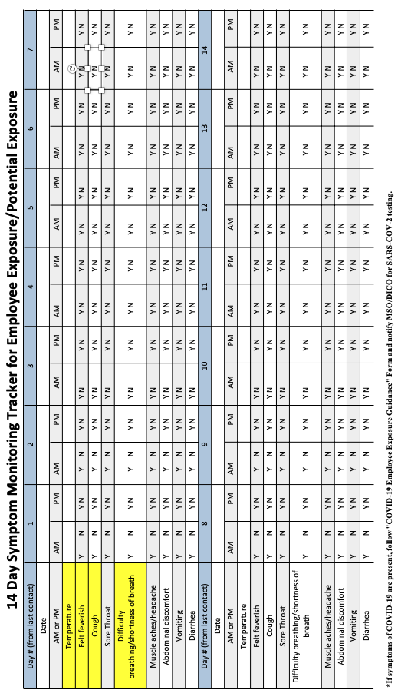
July 30 – August 13, 2020
Subject to Change
COVID-19 Best Practices
Station/Crew Protective Measures
Crew Safety
Response
Department PPE
Checklist
Aerosol Safety
O₂ – Airway Mgt.
Transportation
Notify Hospital
Decontamination
Crew Decon Checklist: Transport Unit
Crew Decon Checklist: Non-transport Unit
Transport Unit Decon Checklist
PPE Preservation
PPE Conservation
UV-C N-95 Mask Disinfection
Station Safety & Sick Personnel
Workflow
BC Algorithm
14-Day Symptom Tracking
Daily Shift Tracking
14-Day Symptom Monitoring: Employee Exposure

Slide 16
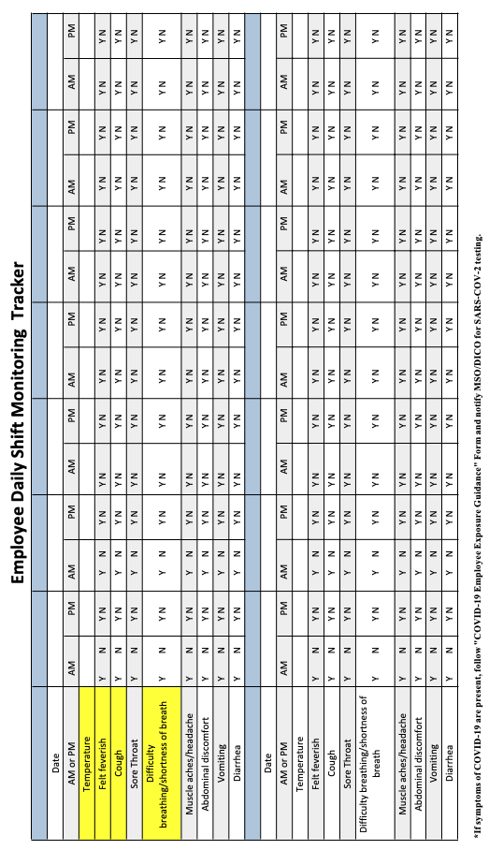
July 30 – August 13, 2020
Subject to Change
COVID-19 Best Practices
Station/Crew Protective Measures
Crew Safety
Response
Department PPE
Checklist
Aerosol Safety
O₂ – Airway Mgt.
Transportation
Notify Hospital
Decontamination
Crew Decon Checklist: Transport Unit
Crew Decon Checklist: Non-transport Unit
Transport Unit Decon Checklist
PPE Preservation
PPE Conservation
UV-C N-95 Mask Disinfection
Station Safety & Sick Personnel
Workflow
BC Algorithm
14-Day Symptom Tracking
Daily Shift Tracking
Daily Shift Monitoring

Slide 17
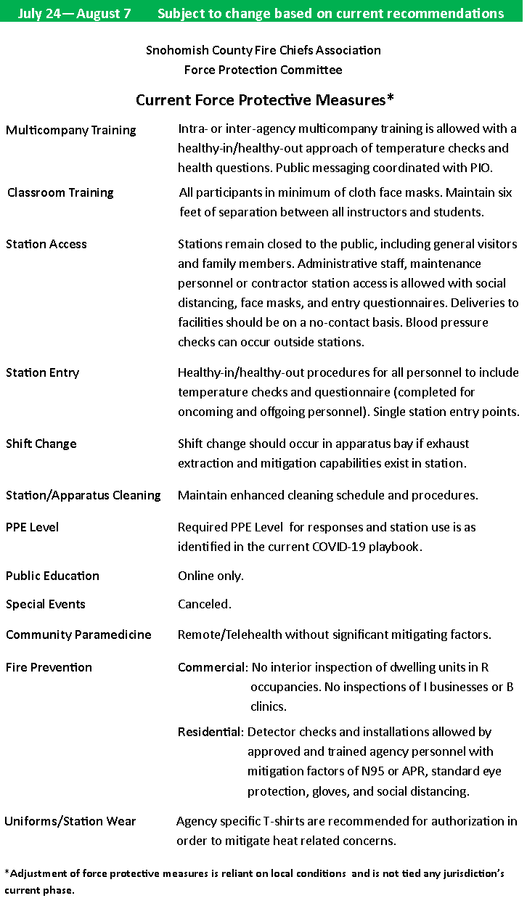

Slide 18
v9
Subject to Change
Transport Unit COVID-19 Crew Checklist
Basic Requirements:
Wear N95, face shield (or goggles), gown, gloves for all providers involved in patient care. (This includes MVCs and other trauma)
Surgical mask on ALL patients
ON SCENE Actions:
Minimize number of crew in contact with patient
Initial doorway triage: 6 ft. separation
ALL STANDARDS OF CARE STILL IN EFFECT
Have patient walk to front door, if appropriate
NO ORAL TEMPS
Transport with maximum ventilation
Driver: remove gloves, gown, & goggles; clean hands before entering cab; only wear N95 while transporting
DECON Actions if Aerosol Generating Procedures Performed on Suspected or Known COVID-19 Patient
AFTER PATIENT TRANSFER (but still at hospital):
Properly dispose of PPE, as per PPE Re-use Practices
Wash hands
Allow patient compartment to air out with doors and windows open for 20 minutes
Deep clean apparatus while wearing PPE (see “Transport Unit DECON CDC Guidelines”)
Disinfect patient compartment with electrostatic sprayer per department procedure
Decon boots with spray CaviCide1
Decon goggles and wash with soap and water
DECON Actions if NO Aerosol Generating Procedures Performed
Properly dispose of PPE, as per PPE Re-use Practices
Wash hands
Deep clean apparatus (see “Transport Unit DECON CDC Guidelines”)
Decon goggles, then wash with soap and water
Launder uniforms as appropriate per agency infection control guidelines
Crews strongly encouraged to do a “Full Tyvek decon” after:
cardiac arrest, combative pt, or anytime crew has concerns for contamination
After rig decon:
Doff and bag uniforms
Clean hands
Don Tyvek suits
Place bagged uniforms in exterior rig compartment
Return to station
Launder uniforms with PPE (Hot water and hot drying)
Shower and don fresh uniforms

Slide 19
v9
Subject to Change
EMS: COVID-19 Hospital Notification Checklist
COVID-19 Symptoms?
Cough
Shortness of breath or difficulty breathing
Fever
Chills
Muscle pain
Sore throat
New loss of taste or smell
Nausea, vomiting, or diarrhea
Possible Exposure to known or suspected Covid patient
YES to ANY symptoms?
Notify hospital of a HIGH risk isolation patient
If NO to ALL: standard hospital notification
At Hospital:
Driver: register patient, coordinate with staff
Alert hospital if aerosol generating procedures
Provider: Doors and windows open for ventilation
Consider keeping patient in rig until ready for transfer
Do not doff PPE until patient transfer
Don clean PPE for gurney decontamination
Doff gurney decon PPE prior to dressing clean gurney

Slide 20
v9
Subject to Change
Non-Transport Unit COVID-19 Crew Checklist
Basic Requirements:
Wear N-95, face shield (or goggles), gown, and gloves for all providers involved in patient care
Including MVCs, other trauma
Surgical mask on ALL patients
ON SCENE Actions:
Minimize number of crew in contact with patient
Initial doorway triage: 6 ft. separation
ALL STANDARDS OF CARE STILL IN EFFECT
Have patient walk to front door, if appropriate
NO ORAL TEMPS
Transport with maximum ventilation
Driver: remove gloves, gown, & goggles; clean hands before entering cab; only wear N95 while transporting
Actions if crew had any patient contact
AT SCENE (If unable to DECON at scene, complete #1-4 on ramp NOT INSIDE THE BAY and Decon inside of rig wearing PPE):
Doff and bag all PPE
Clean hands
Decon boots with spray CaviCide1
Decon goggles and wash with soap and water
Launder uniforms as appropriate per agency infection control guidelines
Crews strongly encouraged to do a “Full Tyvek decon” after:
cardiac arrest, combative pt, or anytime crew has concerns for contamination
AT SCENE
Doff and bag all PPE
Decon boots with spray CaviCide1
Doff and bag uniforms
Clean hands
Don Tyvek suits
Place bagged uniforms in exterior rig compartment
Return to station
Launder uniforms with PPE (Hot water and hot drying)
Shower and don fresh uniforms

